Slide 1
Parent Information

Slide 2
Why we Offer Stars
We saw a need in our community to offer something different in the travel basketball space starting 2017 and we have grown every year.
We are a non-profit program that seeks to develop and pour into the total athlete…pour into players mentally, athletically, and socially.

Slide 3
A higher standard
Control what we control
We will communicate to coaches and players that the two things we can control are our effort and our attitude.
There will be times in the tournaments just like in life where we have to make a decision to handle something the right way – talk to the official appropriately, respect a teammate, coach, opposing team, etc.
We cannot control how people from other programs act during a game, but we can show our players what good composure and leadership looks like to grow them not only in sports but in life.

Slide 4
Schedule
Tryouts - Sunday, January 15
Practice starts week of February 27 (2x a week)
Tournaments start in March
We will play in about 5-7 tournaments. *higher for 11th and 12th teams
Typical Tourney Schedule
1-2 Tournaments in March, 2 in April and 2-3 in May...possibly one in early June. *Some teams will go deeper into the summer.
Typical Tournament game schedule
Friday night game, couple games on Saturday, and if winning, a couple games on Sunday.

Slide 5
Tryout Process
After having thorough tryouts (1st round, make up, call backs) where we have seen everyone for enough time, we will start reaching out to families that we would like to invite onto a team.
We give families 24-48 hours to accept the invite so that we can be efficient to continue to reach out to families.

Slide 6
REGISTRATION
TEAMS
6th -12th Boys & Girls Teams
Registration Fee: ~$630 (10th,11th - $680; 12th - $730) **Includes uniform, long sleeve shooting shirt
Take about 10 players per team and practice player spots available.
Optional
Bookbag/Tag

Slide 7
Practice
Practices will be 1 ½ hours long.
Weekly Schedule – 2 practices per week *set time and day
Practice locations are Johnson ferry, Walton High School, and Pope high school

Slide 8
Safe Harbor
All volunteer coaches are required to fill out the Safe Harbor Application, Policy, and Consent Forms.
Basic background and references check required of all volunteers working with minors at Johnson Ferry.
Once completed it is good for 3 years.
Forms are available online.

Slide 9
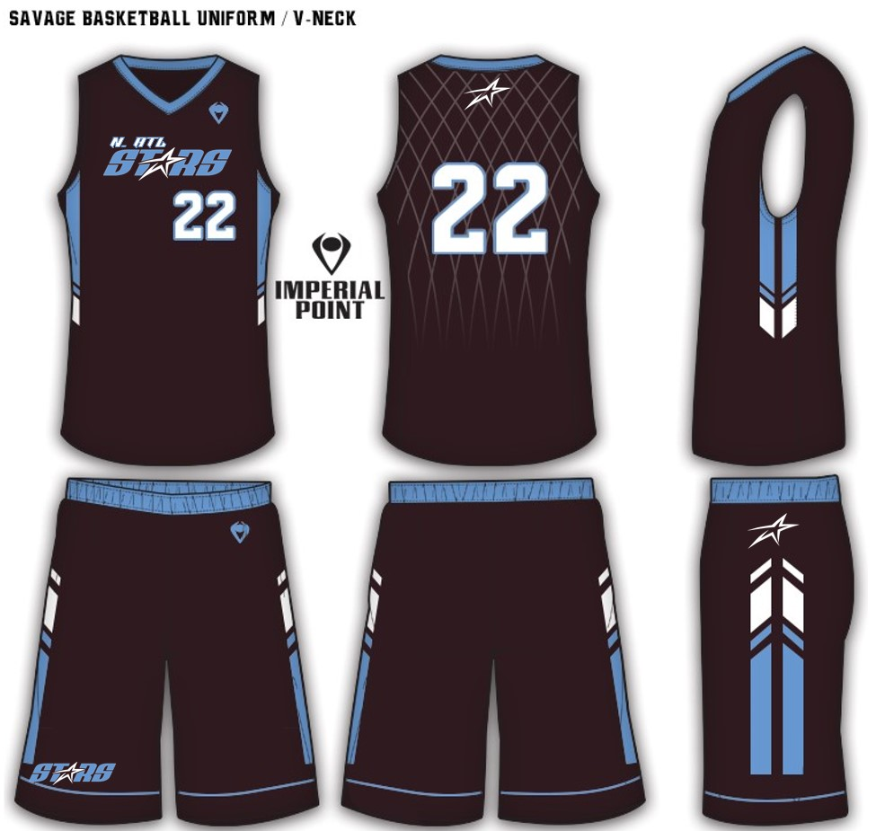
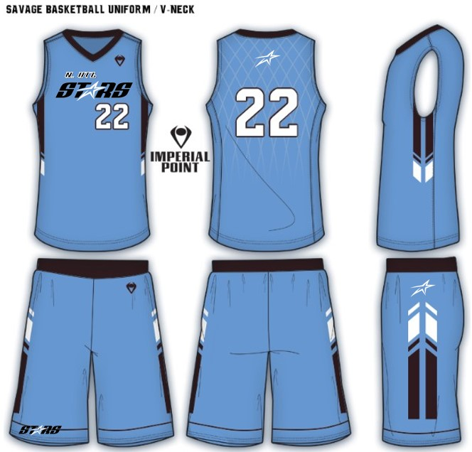
New Uniforms

